Slide 1




April 2025
Mojaloop Foundation Update
Everyone Benefits from an Economy
that Includes Everyone
Paula Hunter, Executive Director

Slide 2

Welcome!

Slide 3
Our Mission
Our mission is to increase financial inclusion by empowering organizations creating interoperable payments systems to enable digital financial services for all.

Slide 4








Mojaloop Foundation Priorities
Community members and donors support the foundation by contributing to initiatives that are in alignment with their mission and impact goals
Requirements
Development
Advocacy
Training
Deployments
Operations
Capture market requirements to drive product strategy and roadmap
With Community, Enhance, test, document, and maintain code base
Educate market and increase awareness and consideration for IIPS
Increase expertise and capacity in the industry to sell, deploy, and operate Mojaloop
Partner with members of the ecosystem to provide implementation services
Customers and/or service providers operate Mojaloop deployments with support from the MLF
2

Slide 5





The Role of the Mojaloop Community
It takes a village to improve financial markets, Mojaloop brings together different organizations to provide a vibrant ecosystem of solutions to facilitate deployment, customization and extension of the software.
Consultants
System Integrators
Technical Solution Providers
Provide analysis, architecture and advisory support to enable adopters to make the best possible choices.
Provide systems integration leadership or support for deployment, implementation, management, extension, customization, while making use of enterprise-grade communications and workflows.
Enable adopters and testers to get started quickly and
easily with test environments, testing toolkits, APIs and
pre-integrated solutions.
Training Organizers
Operations Support / BizOps
Provide standard or tailored training and guidance
for adopters to build the skills needed for deployments
and daily operations.
Provide expertise and best practice guidance or allocate resource capacity for operational support.
3

Slide 6

Mojaloop Foundation Corporate Structure and Governance
Governance
Staff
Councils
Legal Structure
Community Council
Non-profit corporation
All work offered for Public Good
Open-Source licenses for all code
Operations and staff funded by grants and membership dues
No income derived from software or services
CEO / Executive Director
Product Council
Board of Directors
Chair
Secretary
Treasurer
Design Authority
Technical Governing Board
Change Control Board
4

Slide 7
Deployments and Country Activity
Steve Haley
Director of Market Development and Partnerships

Slide 8
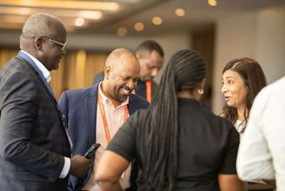
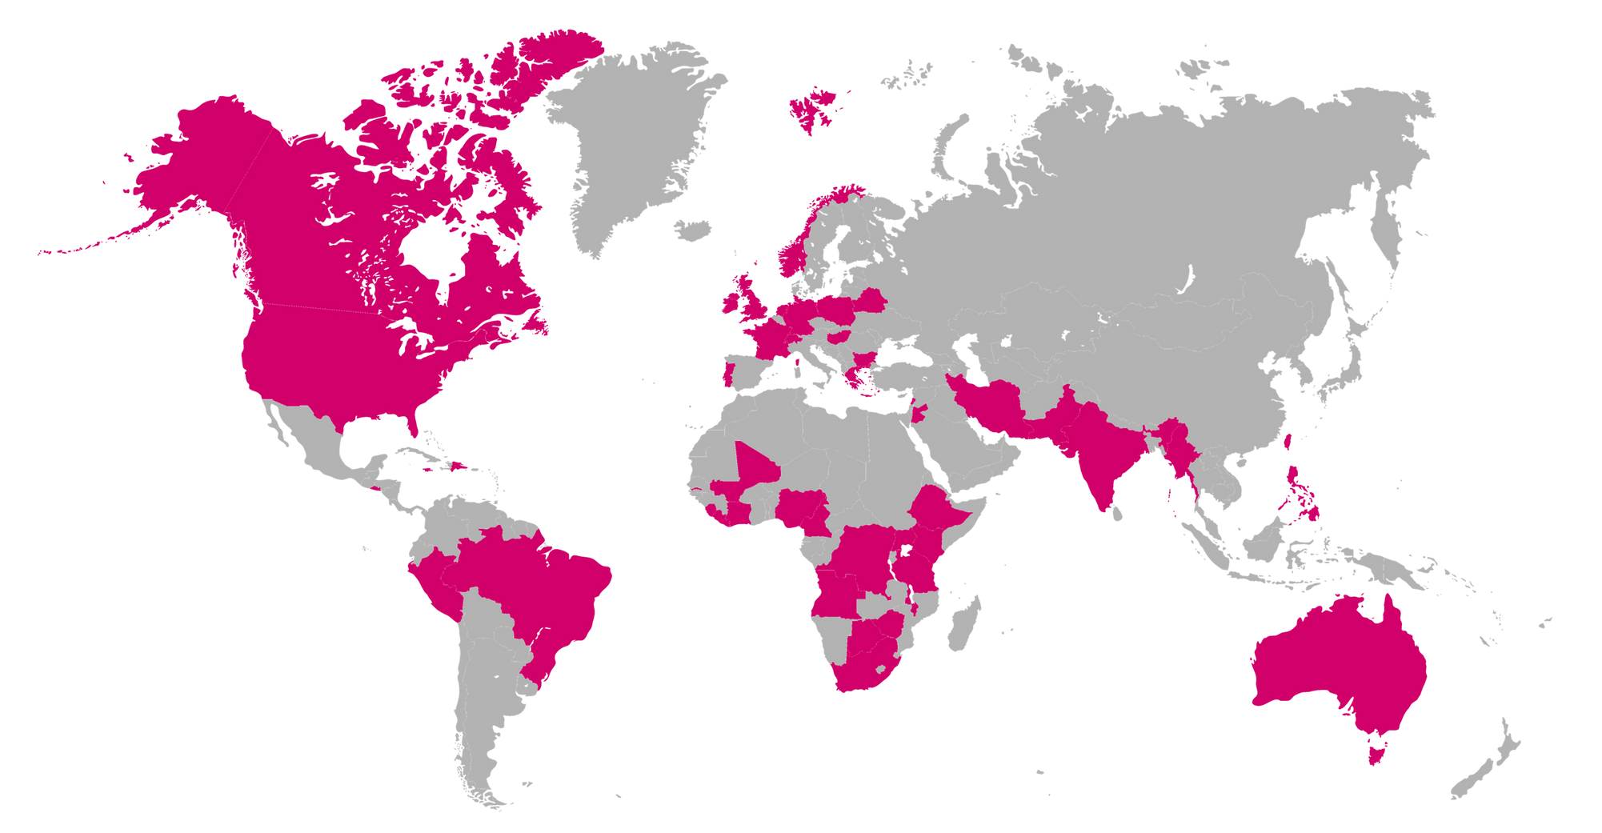
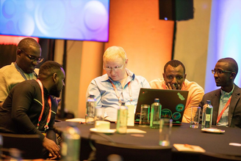


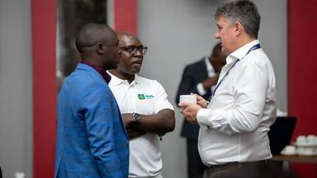

Countries at this event
Ghana
Rwanda
Uganda
Kenya
Zambia
Somaliland
Guinea
Cape Verde
Togo
The Gambia
Liberia
Malawi
Malaysia
The Philippines
Sierra Leone
South Sudan
5
Notes:
1.7.2013
5
‹#›

Slide 9





News! RSwitch’s Mojaloop goes live!
• Launched at the Inclusive Fintech Forum
• Use case: Merchant payments
• Congratulations to the RSwitch and WiredIn teams
• Thanks to AfricaNenda for driving the project
7

Slide 10
Accelerator Program
Accelerated course of study and experience for technical service providers:
Online and in person training
Concrete technical experience
Sessions with expert mentors
Contact: Simeon Oriko
Previous accelerator cohorts:
Rwanda
Zambia / Malawi
Kenya
South Sudan
Cape Verde
New cohorts will not be country based
Applications for the next session closing this week
https://mojaloop.io/mojaloop-accelerator-program-april-2025-cohort/
9

Slide 11
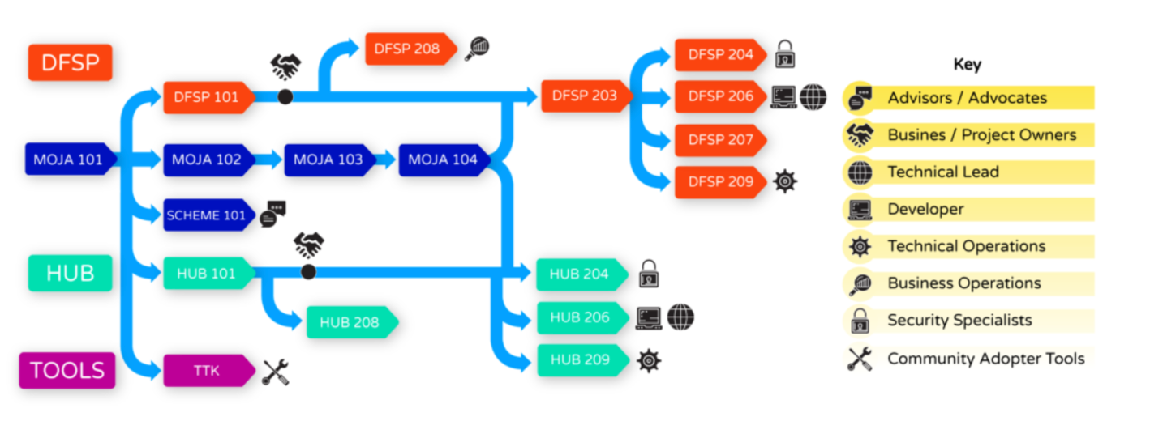
Mojaloop Training Program
10

Slide 12


















Service Provider Directory
• 18 listed – up from 7
• Technical and non-technical service providers
• Regular update calls to members
11

Slide 13




Partner Program
Improve the Mojaloop product
Drive adoption of Inclusive Instant Payment Systems
Organizations that align with our mission but don’t fit into the category of service provider or member
12

Slide 14



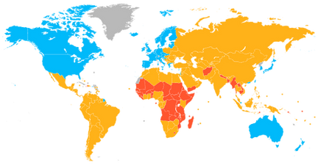


The Future of Instant Payments
A growing force in the payments sector
Developing countries transitioning to newer tech
Opportunity for venture backed startups and Fintechs

